Slide 1

The Yelp Effect: From Reviews to Results
Shristi Kumar * Sujan Govindaraju * Kartheek Alluri * Mahak Gupta

Slide 2
Abstract
Yelp is an online platform where users rate and review local businesses, fostering a community-driven business directory through reviews, ratings, and check-ins.
It provides rich, user-generated content that reflects real-world customer experiences and expectations.
Our project leverages Yelp’s business dataset to unlock hidden patterns and insights using:
🔄 ETL techniques for data extraction, transformation, and loading
🧩 NoSQL data modeling for flexible and scalable data structuring
💬 Sentiment analysis to decode customer emotions and satisfaction levels
:

Slide 3

Motivation
Modern decisions are review-driven.
Reviews reflect honest, community-based feedback.
We aim to analyze this data for business strategy using ETL and analytics.

Slide 4
Problem Statement
“How can businesses in different industries improve customer satisfaction and engagement based on reviews and check-ins?”"

Slide 5
Objectives
Identify key drivers of positive experiences
Detect common issues across industries
Perform Dimension Modeling to obtain quick insights on industries
-Enable data-driven decisions for businesses

Slide 6
Literature Review
Online reviews offer sentiment-rich data
ML-based sentiment analysis of Yelp reviews
MongoDB vs Cassandra NoSQL systems
Dimensional modeling guided by Kimball

Slide 7
Workflow
DATA COLLECTION AND EXPLORATION
TOOLS USED
PYTHON
DATA CLEANING & PREPARATION
TOOLS USED
PYTHON
SENTIMENT ANALYSIS
TOOLS USED
ALTRYX -> ORANGE
DATA MODELING
ETL PIPELINE
TOOLS USED
APACHE AIRFLOW
SNOWFLAKE
VISUALIZATION
TOOLS USED
TOOLS USED
PYTHON

Slide 8
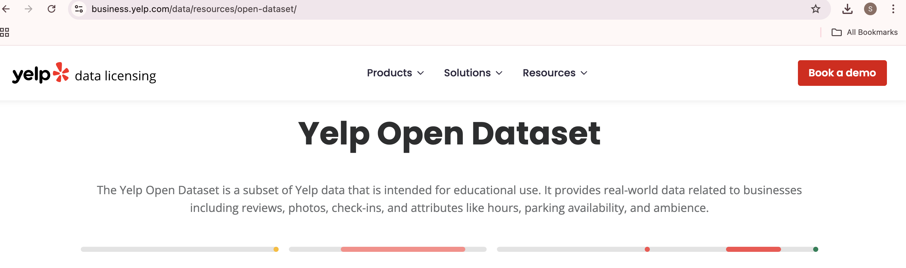
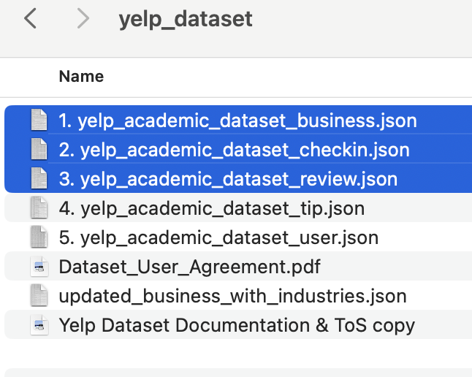
DATA COLLECTION AND EXPLORATION TOOLS USED: PYTHON

Slide 9
DATA CLEANING & PREPARATION
DATA CLEANING
DATA PREPERATION
FEATURE ENGINEERING

Slide 10
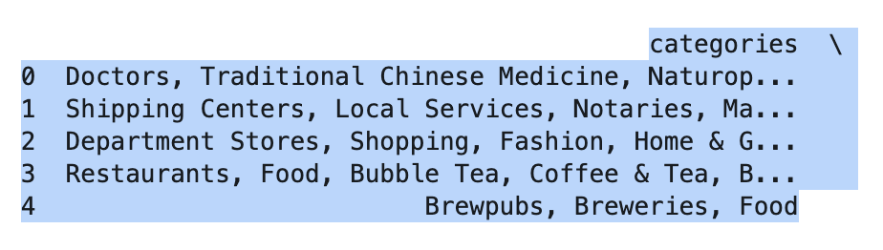
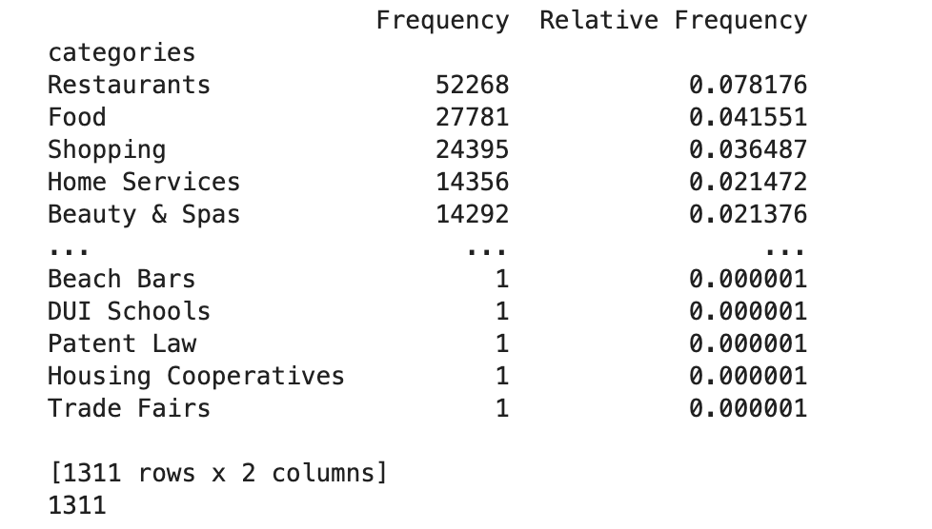
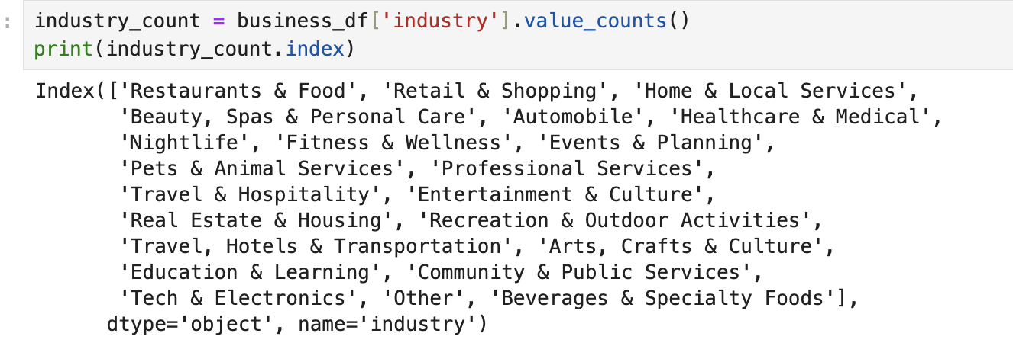
DATA PREPARATION
(Business Dataset)

Slide 11
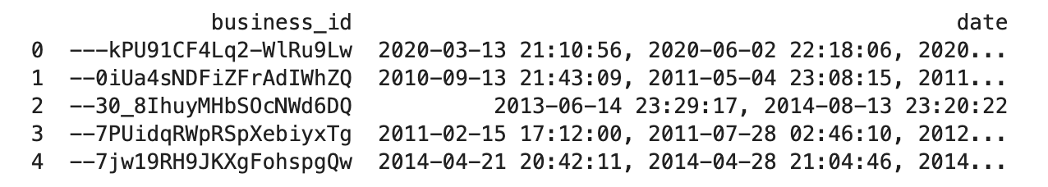
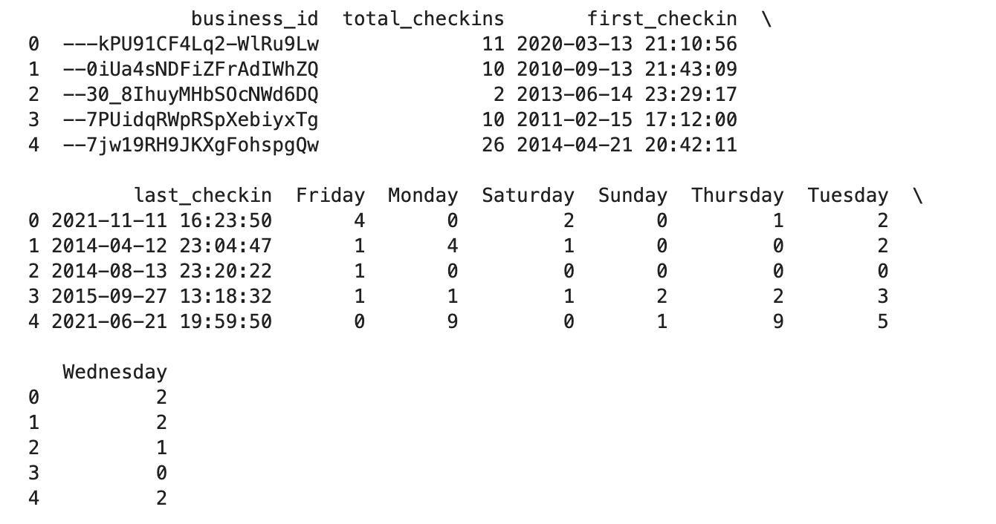
DATA PREPARATION
(Checkin_Dataset)

Slide 12
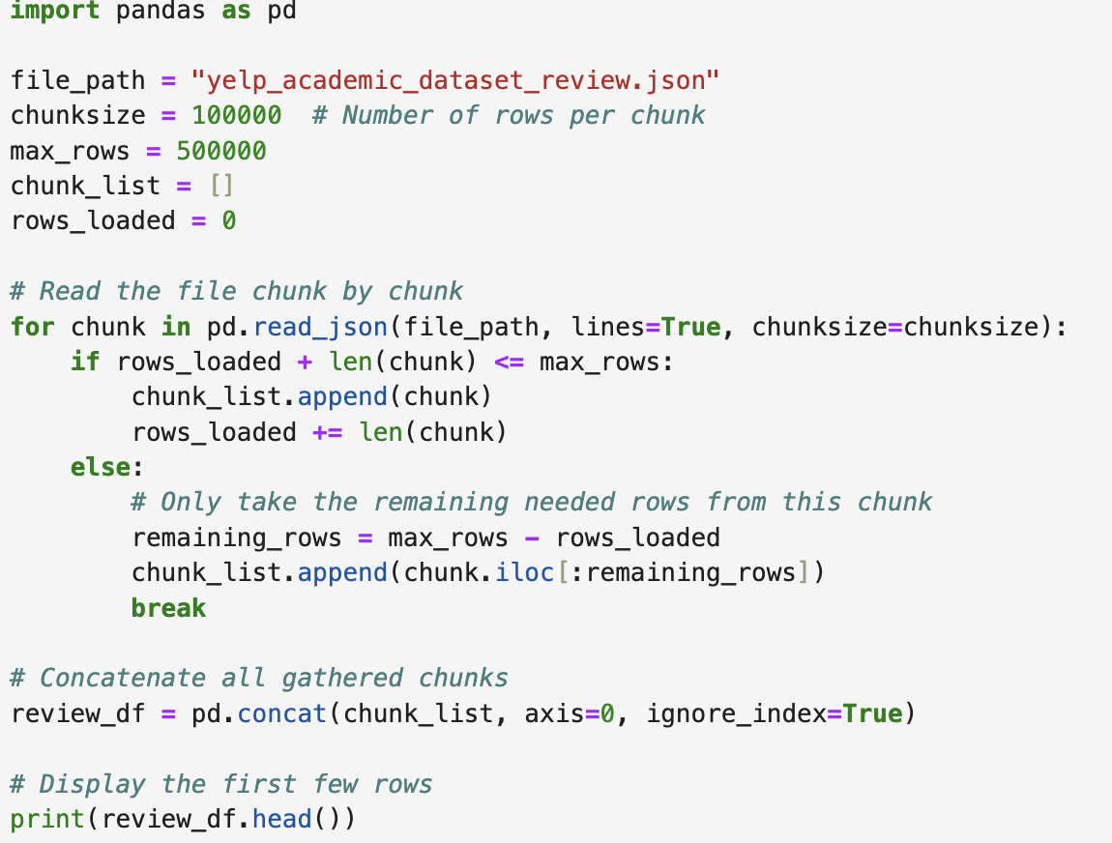
DATA PREPARATION
(Review Dataset)

Slide 13

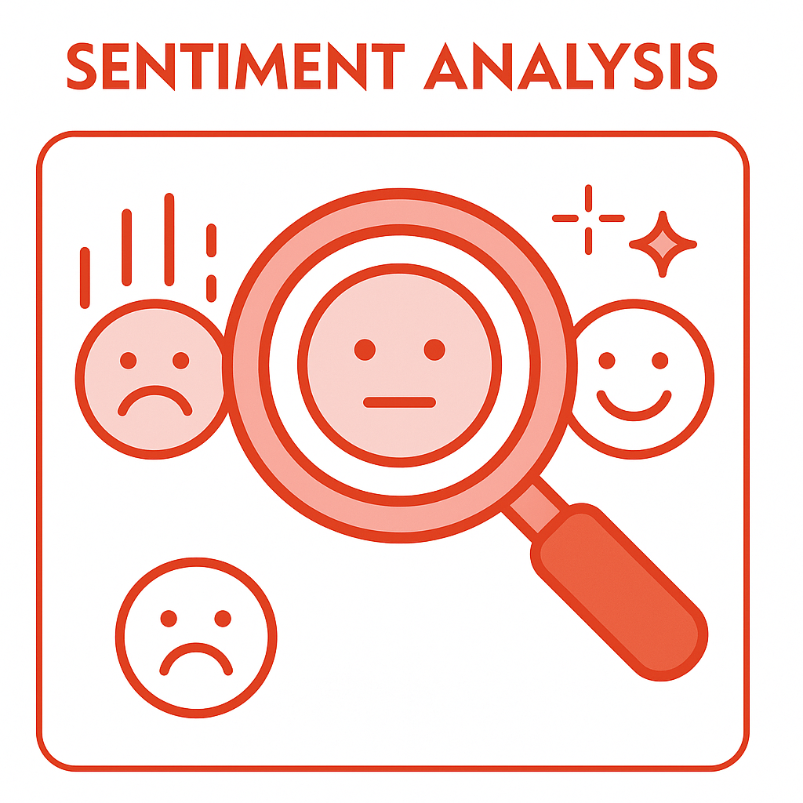

SENTIMENT ANALYSIS
ALTRYX
ORANGE

Slide 14
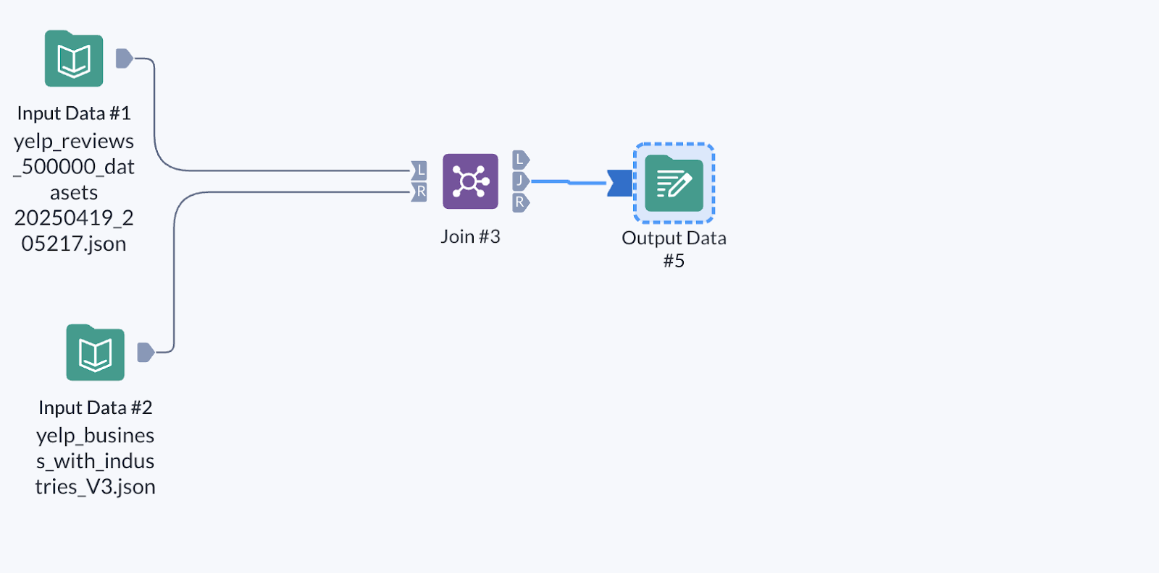
ALTRYX PIPELINE

Slide 15
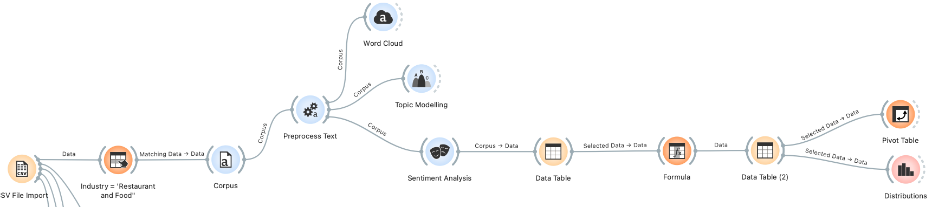
ORANGE PIPELINE

Slide 16
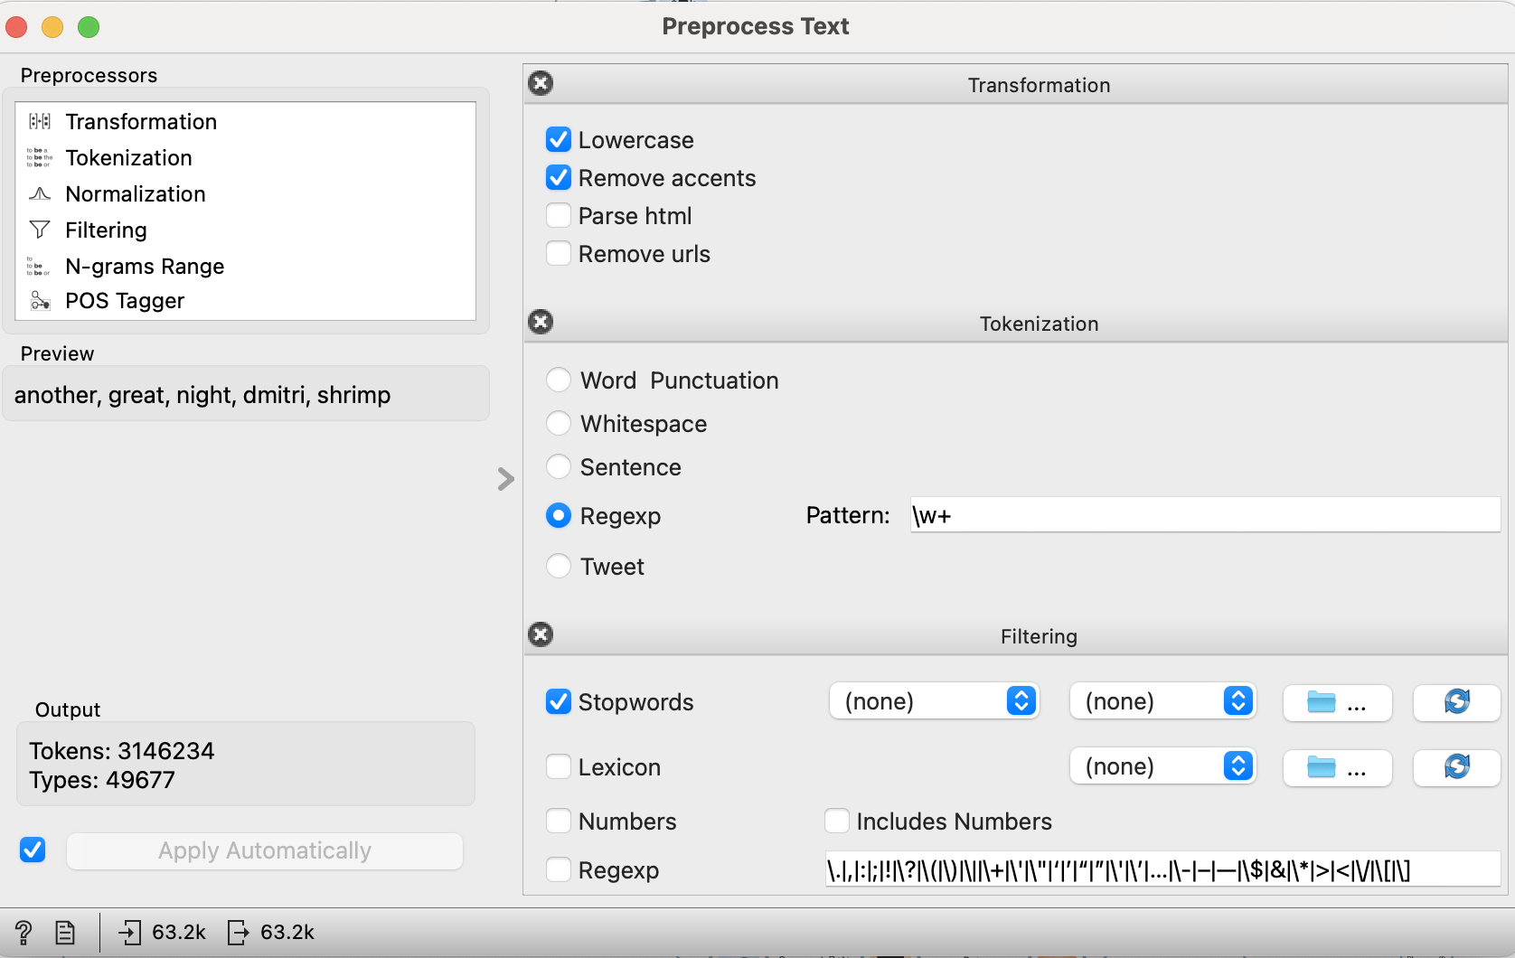
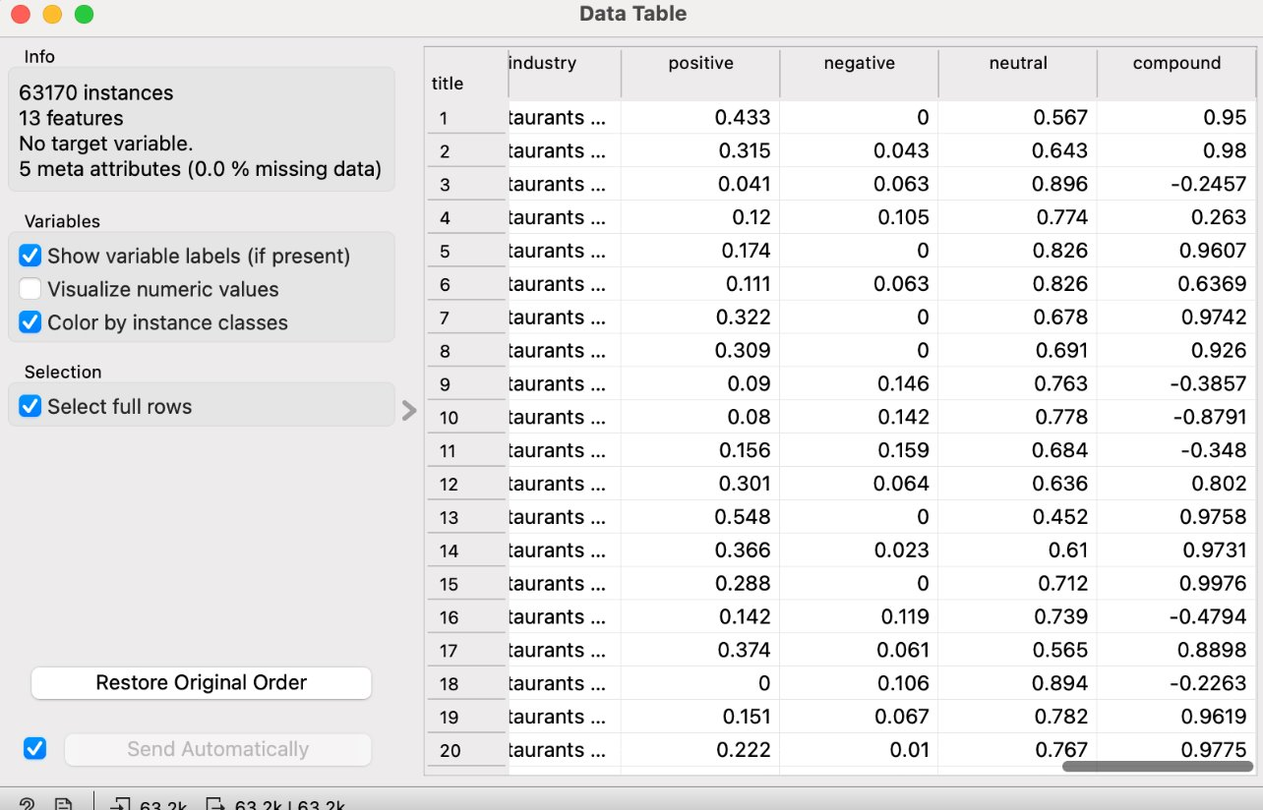
ORANGE PIPELINE

Slide 17
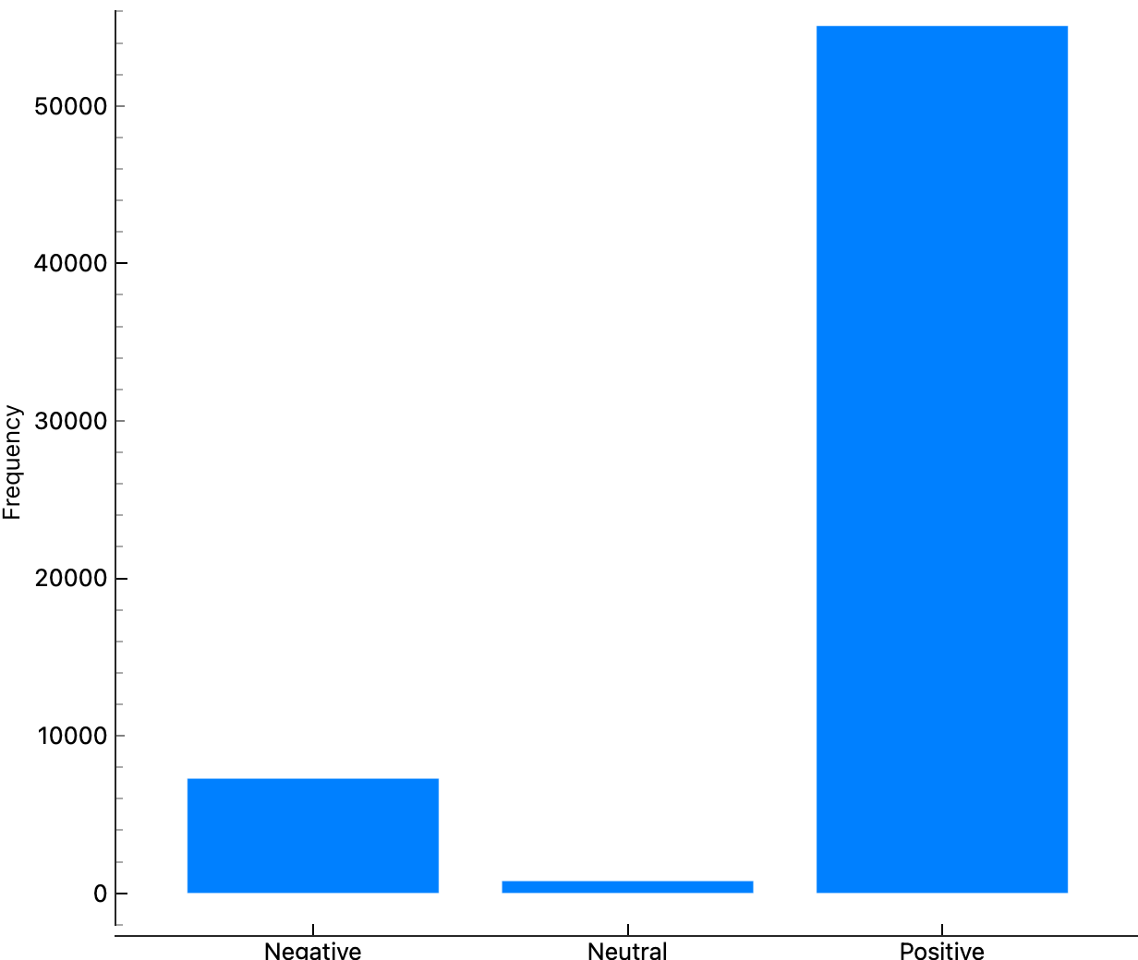
ORANGE PIPELINE

Slide 18
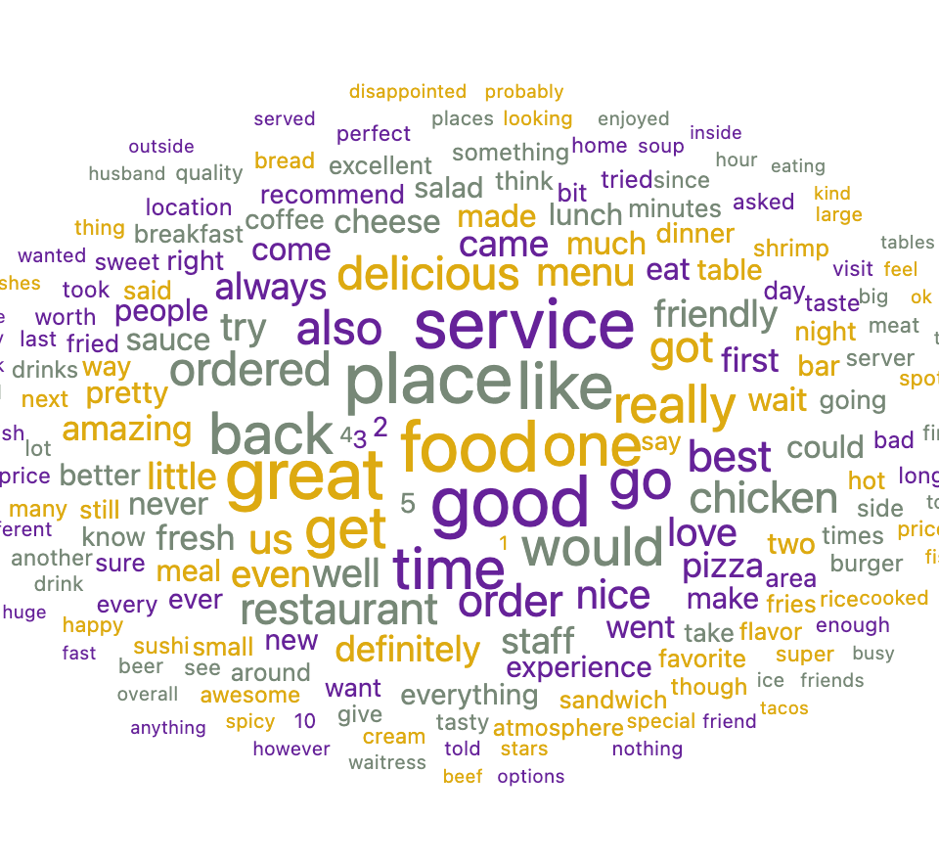
ORANGE PIPELINE

Slide 19
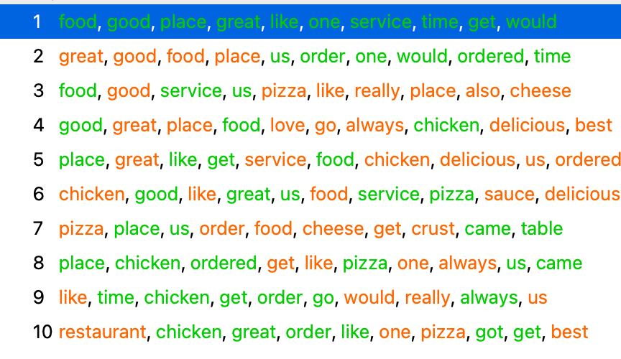
ORANGE PIPELINE

Slide 20
K E Y L E A R N I N G S
ALTRYX
Cloud Native has limited functionalities
Performance is powerful
ORANGE
Very user-friendly
Text mining tool is self- explanatory
Supports various file types, cloud storage
Desktop is only limited to Windows
Pipeline runs every time the system is open
Not flexible to file types

Slide 21


ETL Pipeline

Slide 22
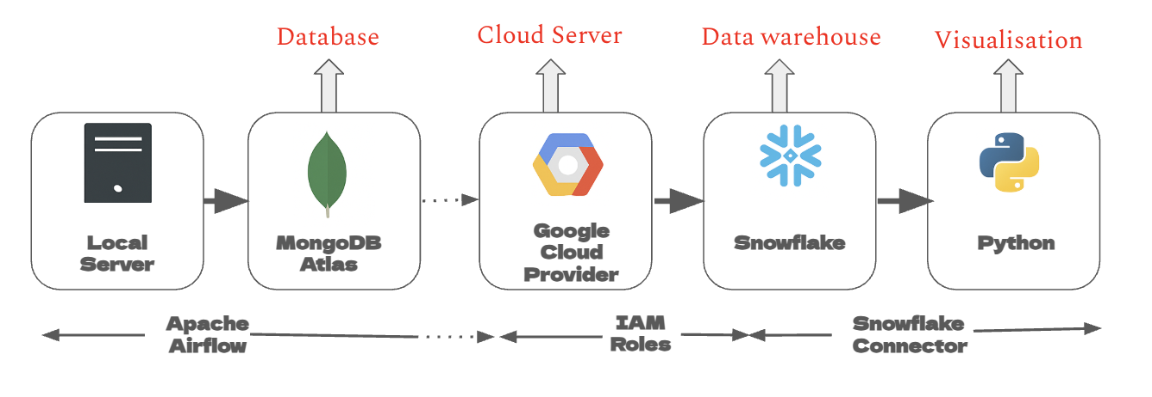
ETL Pipeline

Slide 23
LOCAL SERVER to MONGODB ATLAS
It was loaded through Apache Airflow DAGs. Apache airflow was set up via Homebrew.
The DAGs were created using Shell scripting in the local server.
The Review Dataset was again refined to have only sentiment_score and not full review text.
It was done to automate the process.

Slide 24
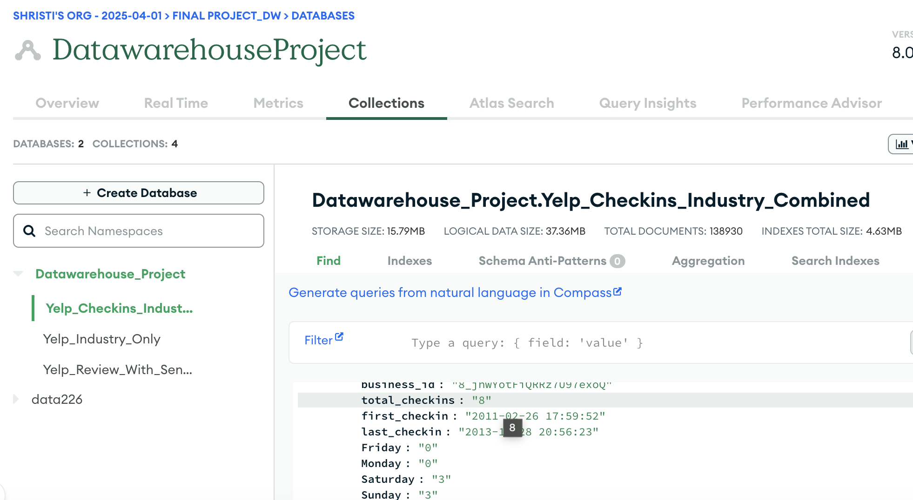

Slide 25
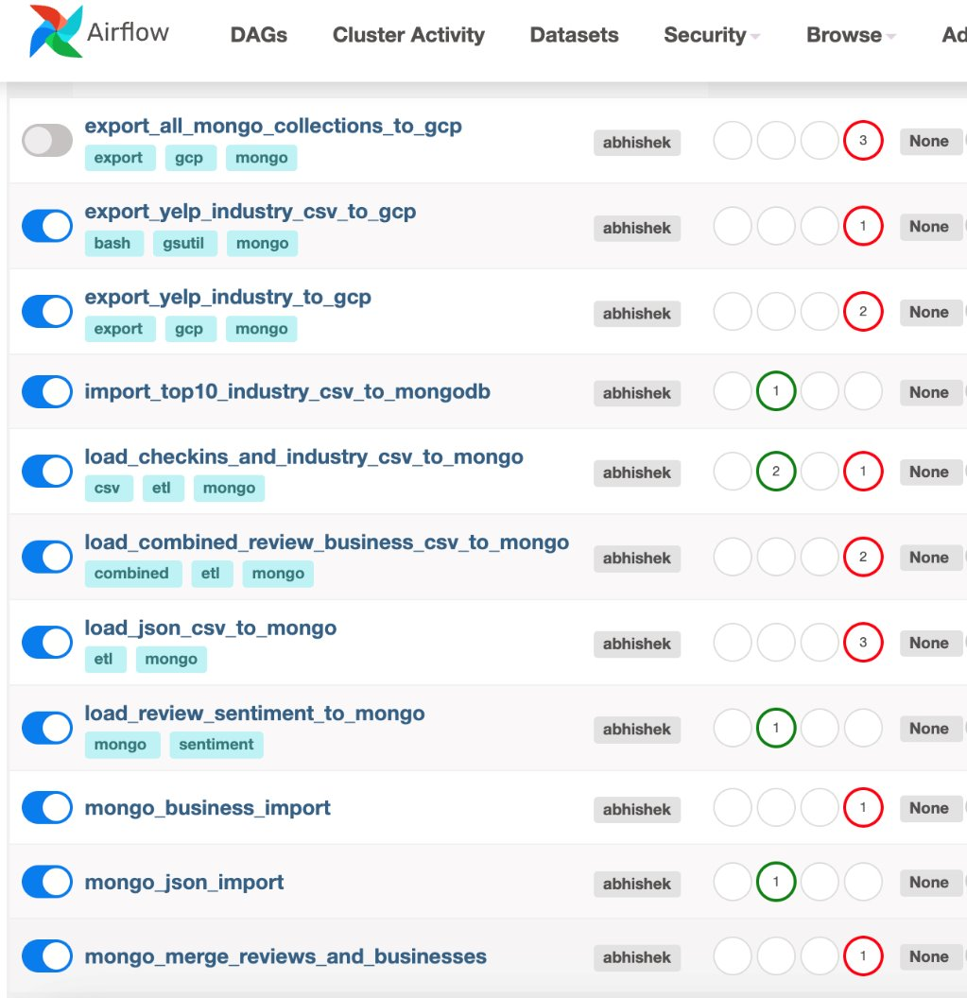
MongoDB ATLAS to GCP
Apache Airflow was set up to connect to GCP
However, the data was not connecting and getting added to the GCP bucket, it was throwing errors.
After key consideration, the data was shifted manually to the GCP bucket

Slide 26
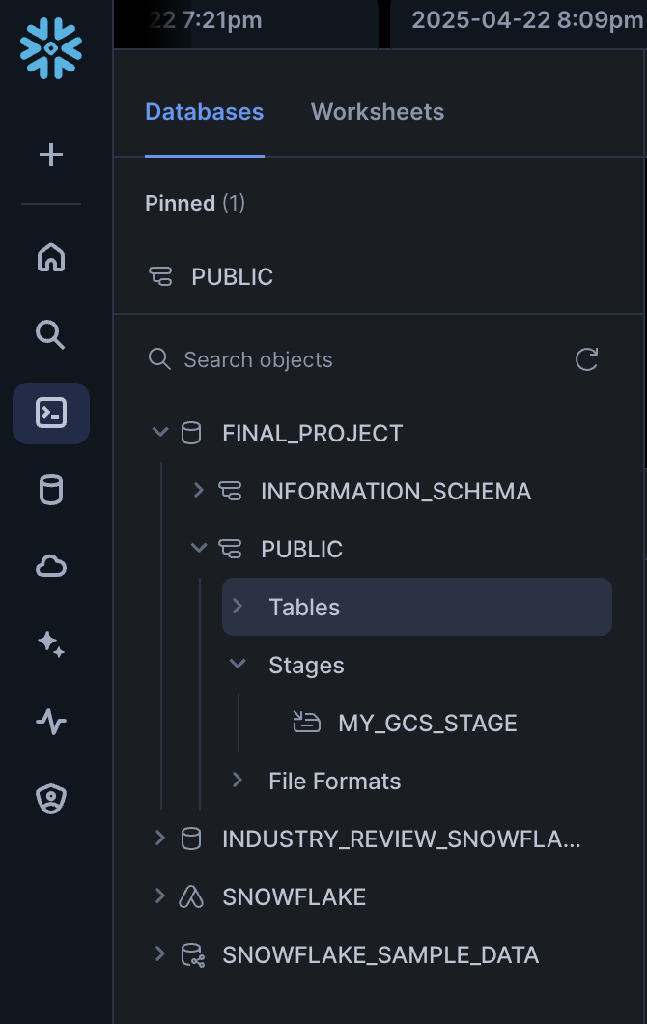
GCP to Snowflake
Snowflake has smooth connections to GCP
The GCP bucket was provided with desired IAM permissions were granted and the API key was generated
In Snowflake we had to run codes to first create a staging area
The other SQL commands were to created SCHEMA structure for each of the three tables.

Slide 27
Snowflake to Python
The connection here again was seamless
Python has Snowflake.connector library
That was used on top of matplotlibrary and seaborn to get the desired visualization. Thus, ending our ETL pipeline here.

Slide 28



Data Modeling

Slide 29
KEY CONSIDERATIONS
STAR over SNOWFLAKE
Fact Constellation Requirement
Availability of less Dimension attributes
Creation of new dimensions
Excluding user data
Denormalise where there is a possibility

Slide 30
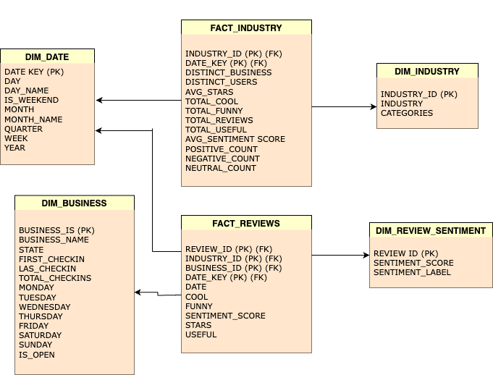

Slide 31
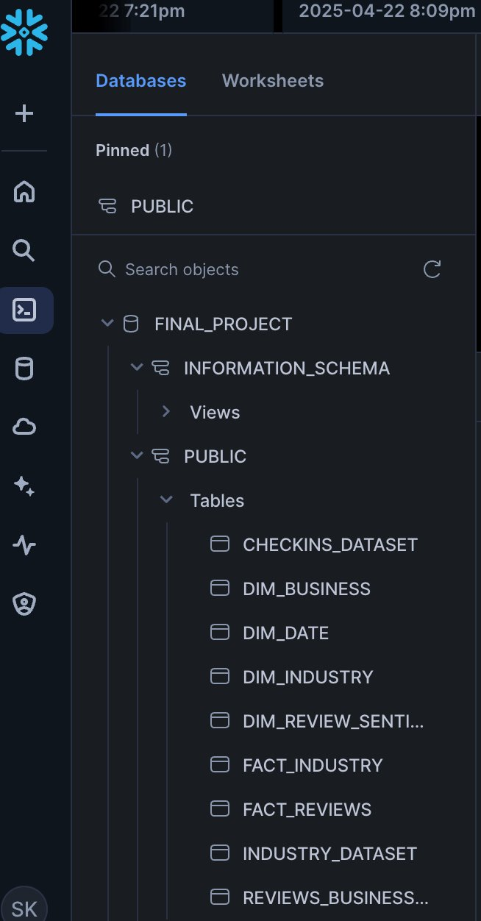
Snowflake Shema

Slide 32

Visualization

Slide 33
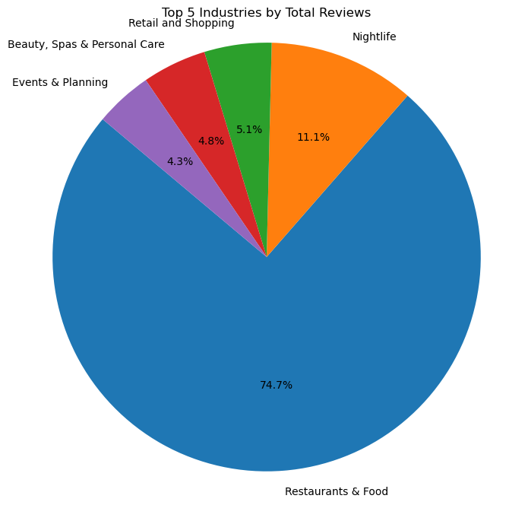
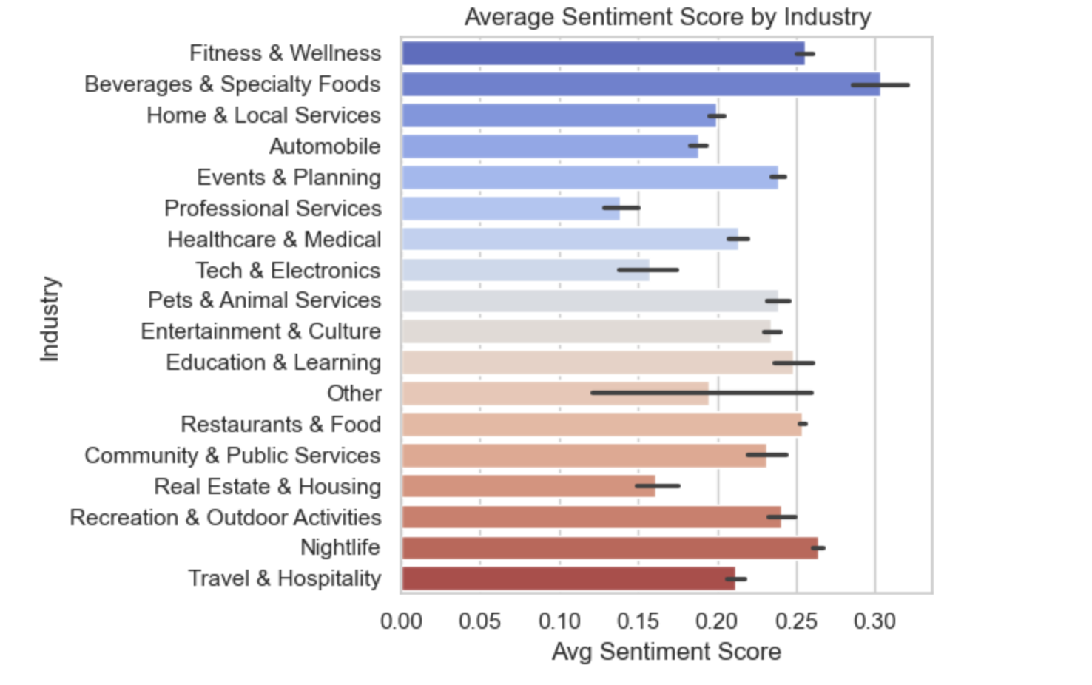

Slide 34
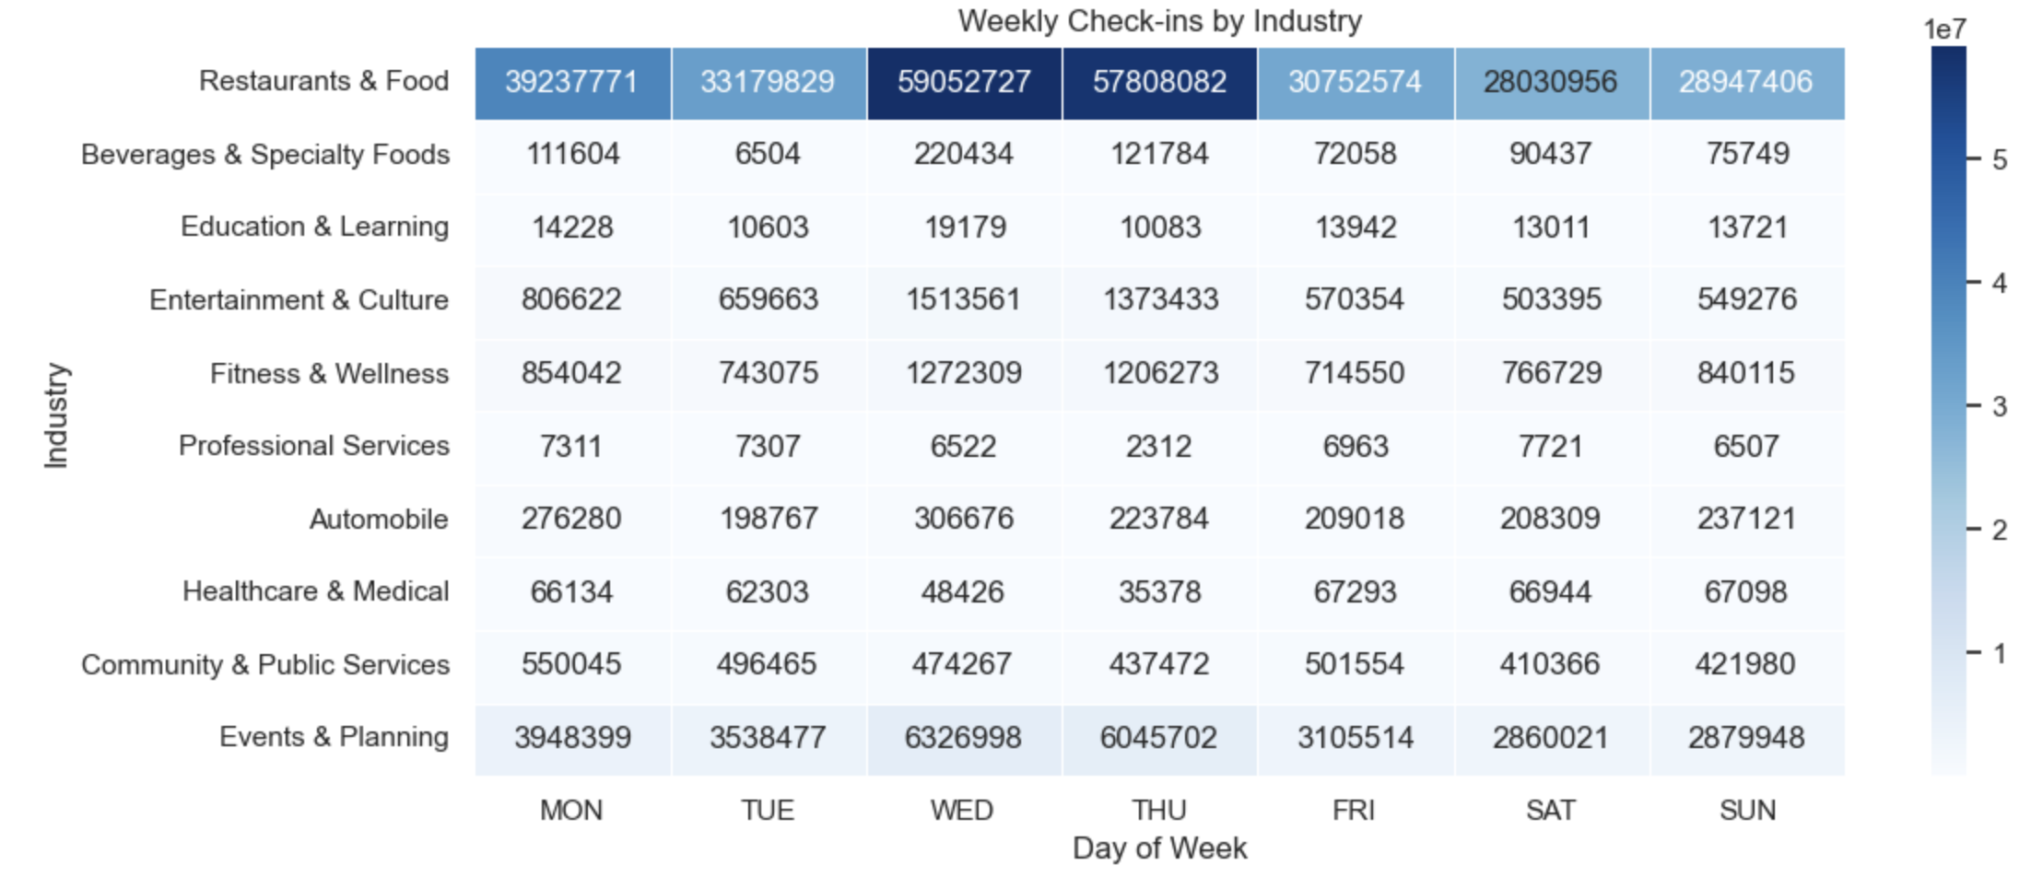

Slide 35
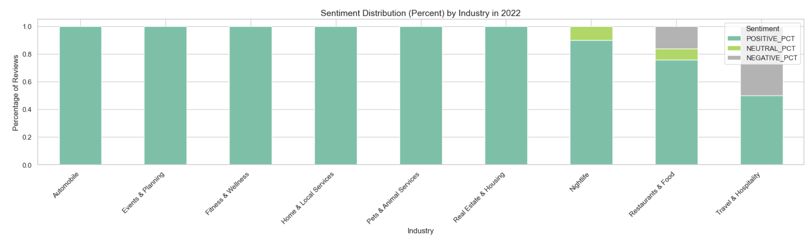

Slide 36
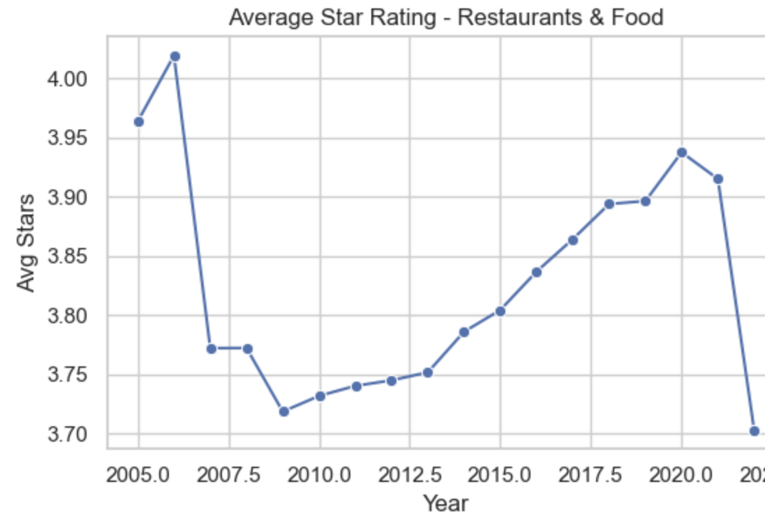

Slide 37
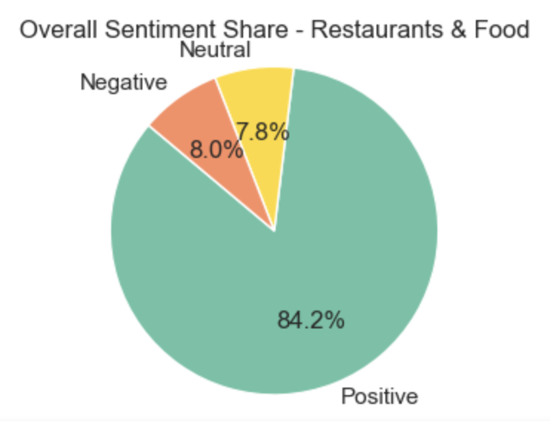
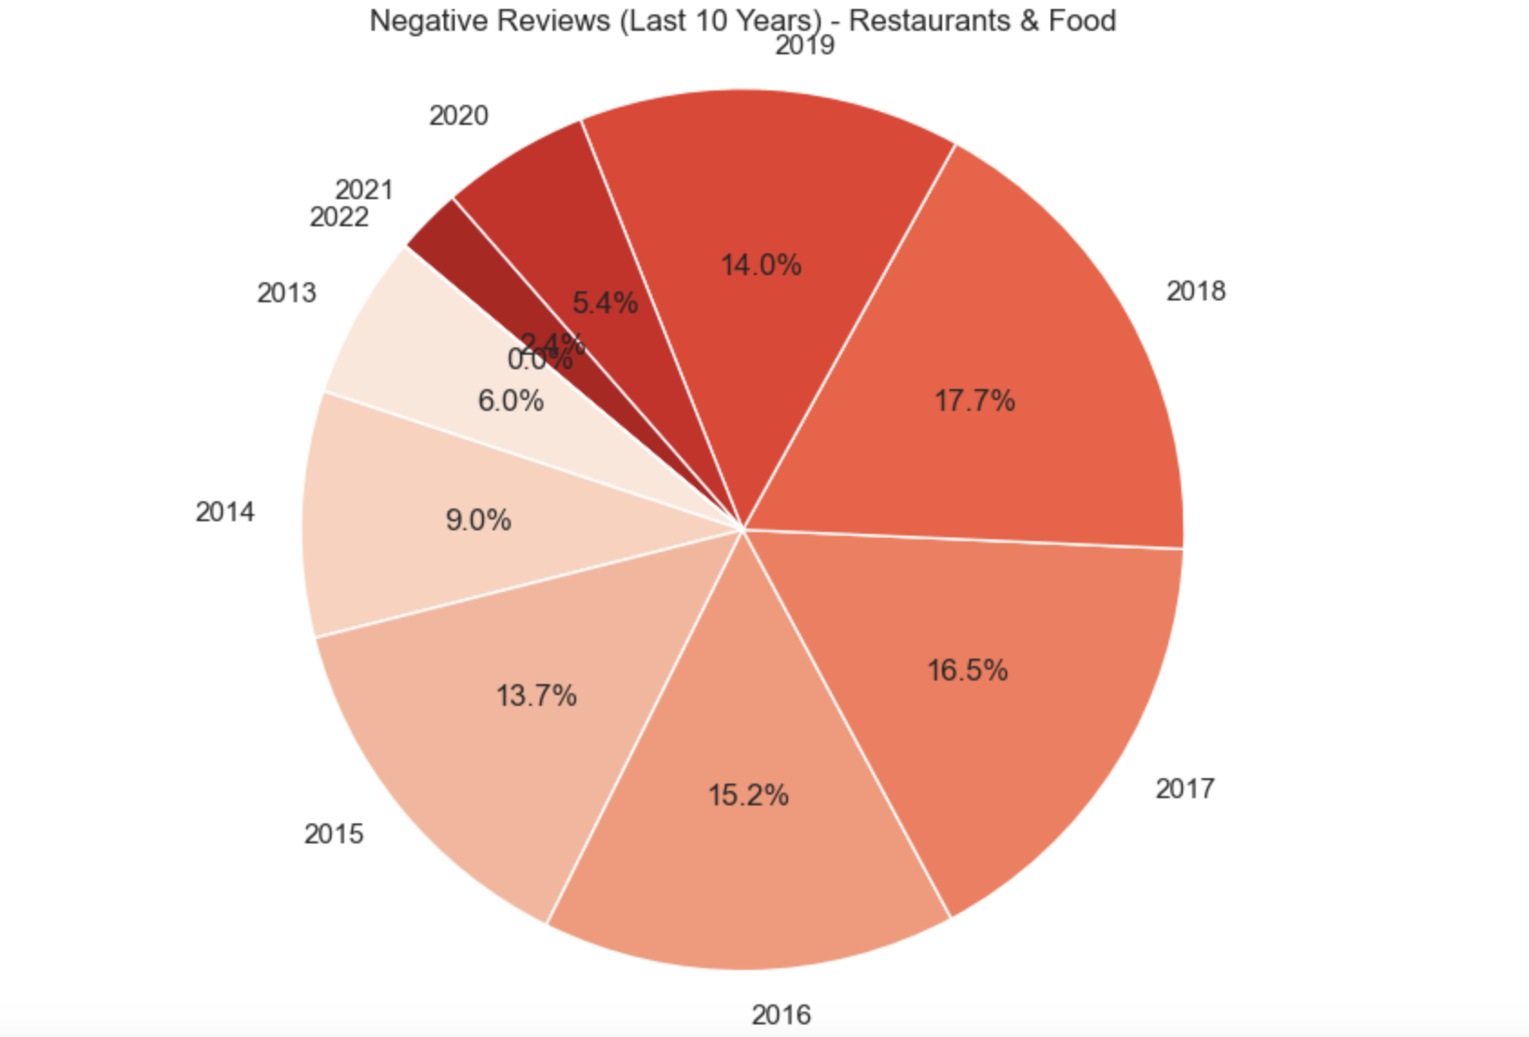

Slide 38
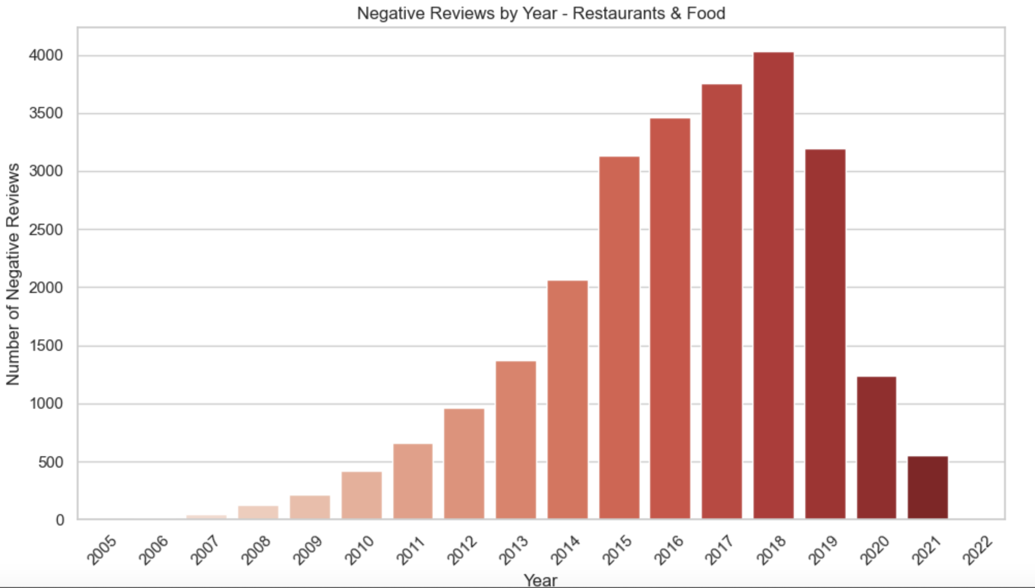

Slide 39

TECHNICAL DIFFICULTIES

Slide 40
Key Points
🔍 Logical Designing is must
🦠 Data pre-processing on the basing of use case
⚠️ Dimension modeling
🧭 Establishing MongoDB and GCP connection
🔍 Performance issue to due to heavy data size
🦠Free tier limitations

Slide 41
KEY LEARNINGS

Slide 42
🔍 Review-Centric Industries
🦠 Impact of COVID-19
⚠️ Negative Review Awareness
🧭 Emerging Sectors to Watch
Based on Analysis

Slide 43
🧠 Start with Logical Design
🧰 Explore Tools Before Use
🔁 Automate the ETL Pipeline End-to-end automation
⏱️ Master Time Management
Based on technical experience

Slide 44
Acknowledgments
Dr. Vishnu Pendyala – Project Mentor
Kanchan Ashok Naik & Mayank Kapadia – Teaching Assistants

Slide 45
KEY LINKS
Github Link: https://github.com/Mahak202/DataWarehouseProject
Drive link: https://drive.google.com/drive/folders/1ladKDycK4rBY3kUg4T3GFZWDSLkECFAJ?usp=drive_link
Dataset Link: https://business.yelp.com/data/resources/open-dataset/

Slide 46

Thank you, Questions???

